Slide 1
Neural Network Components and Data Flow
Understanding layers, neurons, weights, activation functions, loss functions, and optimization algorithms
:BY – LAXMI LAHARI NAIDU BUGATA

Slide 2
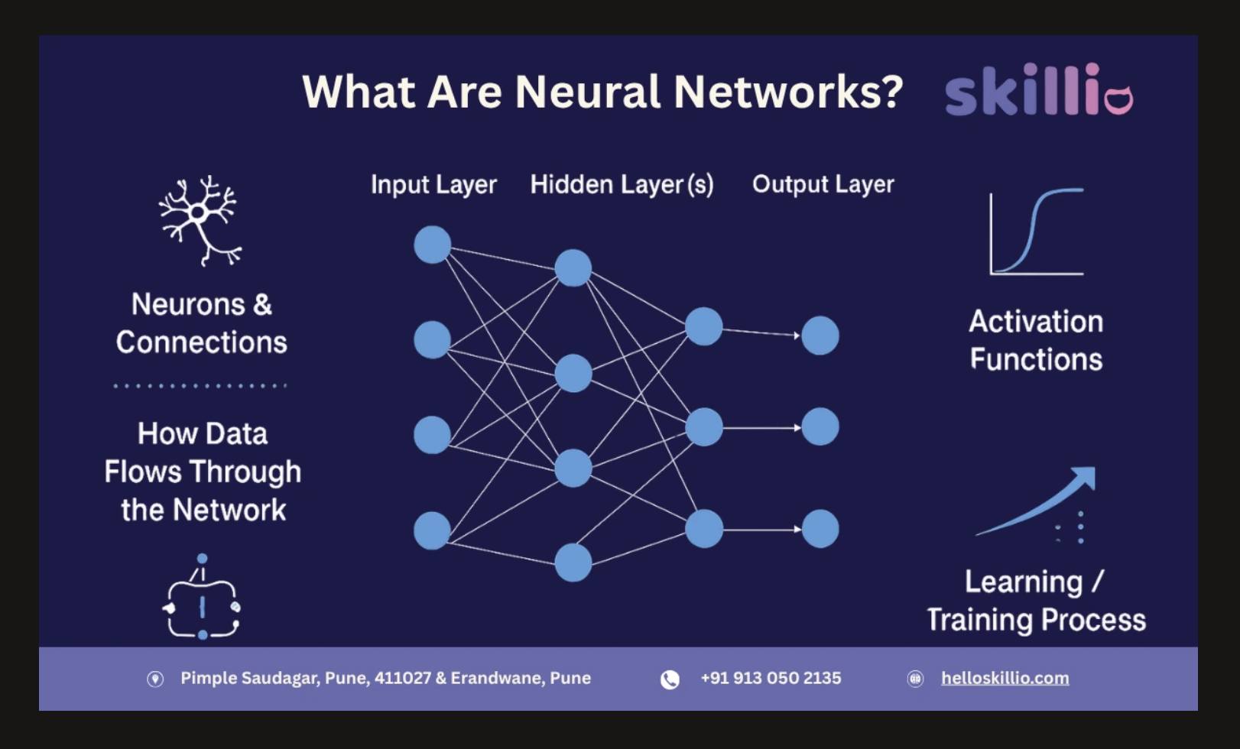
Neural network flowchart

Slide 3
Neural network flowchart
Input Layer: Receives the original features or data values.
Neurons: Small processing units that combine inputs and produce outputs.
Weights: Values that control how strongly signals move between neurons.
Hidden Layers: Transform input data into useful internal patterns.
Activation Function: Adds nonlinearity so the network can learn complex relationships.
Output Layer: Produces the final prediction or classification result.
Loss Function: Measures how far the prediction is from the correct answer.
Optimization: Updates weights to reduce loss during training.

Slide 4
Layers and neurons
Layers: Layers are the stages of a neural network that organize how data moves through the model, usually from an input layer to one or more hidden layers and finally to an output layer.
Neurons: Neurons are the basic processing units in the network. Each neuron receives inputs, combines them, applies a function, and sends an output forward.

Slide 5
Weights and activation functions
Weights: Weights are adjustable values attached to connections between neurons. They control how strongly one input or neuron influences the next stage of the network.
Activation Functions: Activation functions are mathematical rules applied to a neuron’s weighted input. They introduce nonlinearity, which allows the network to learn complex patterns instead of only simple linear relationships.

Slide 6
Loss functions and optimization algorithms
Loss Functions: Loss functions measure how far the model’s prediction is from the correct answer. Training aims to reduce this loss over time.
Optimization Algorithms: Optimization algorithms update the weights to reduce the loss. Methods such as gradient descent help the network improve its predictions during training.

Slide 7
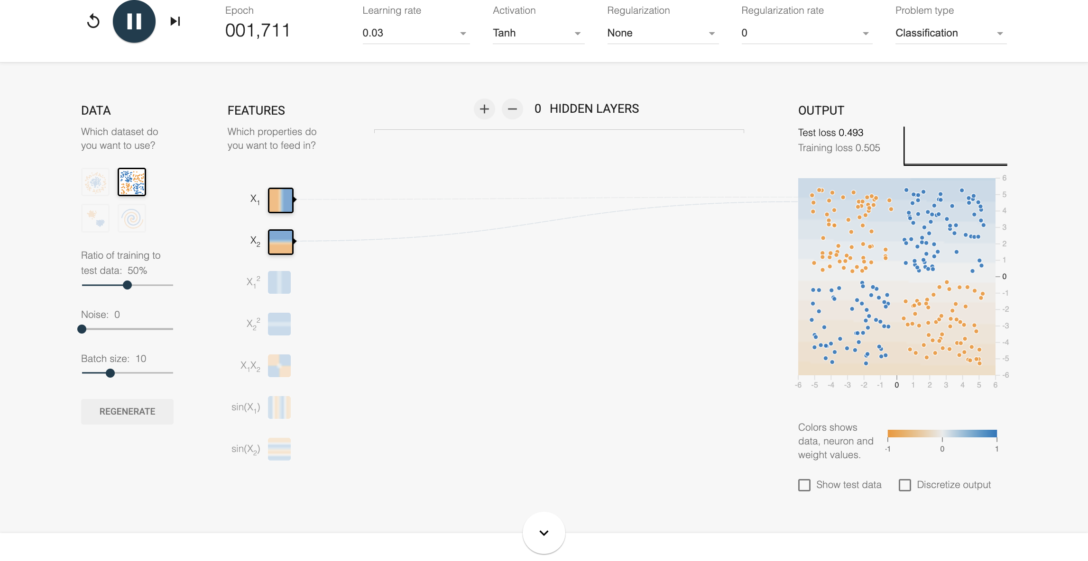
TensorFlow Playground example 1: simple model

Slide 8
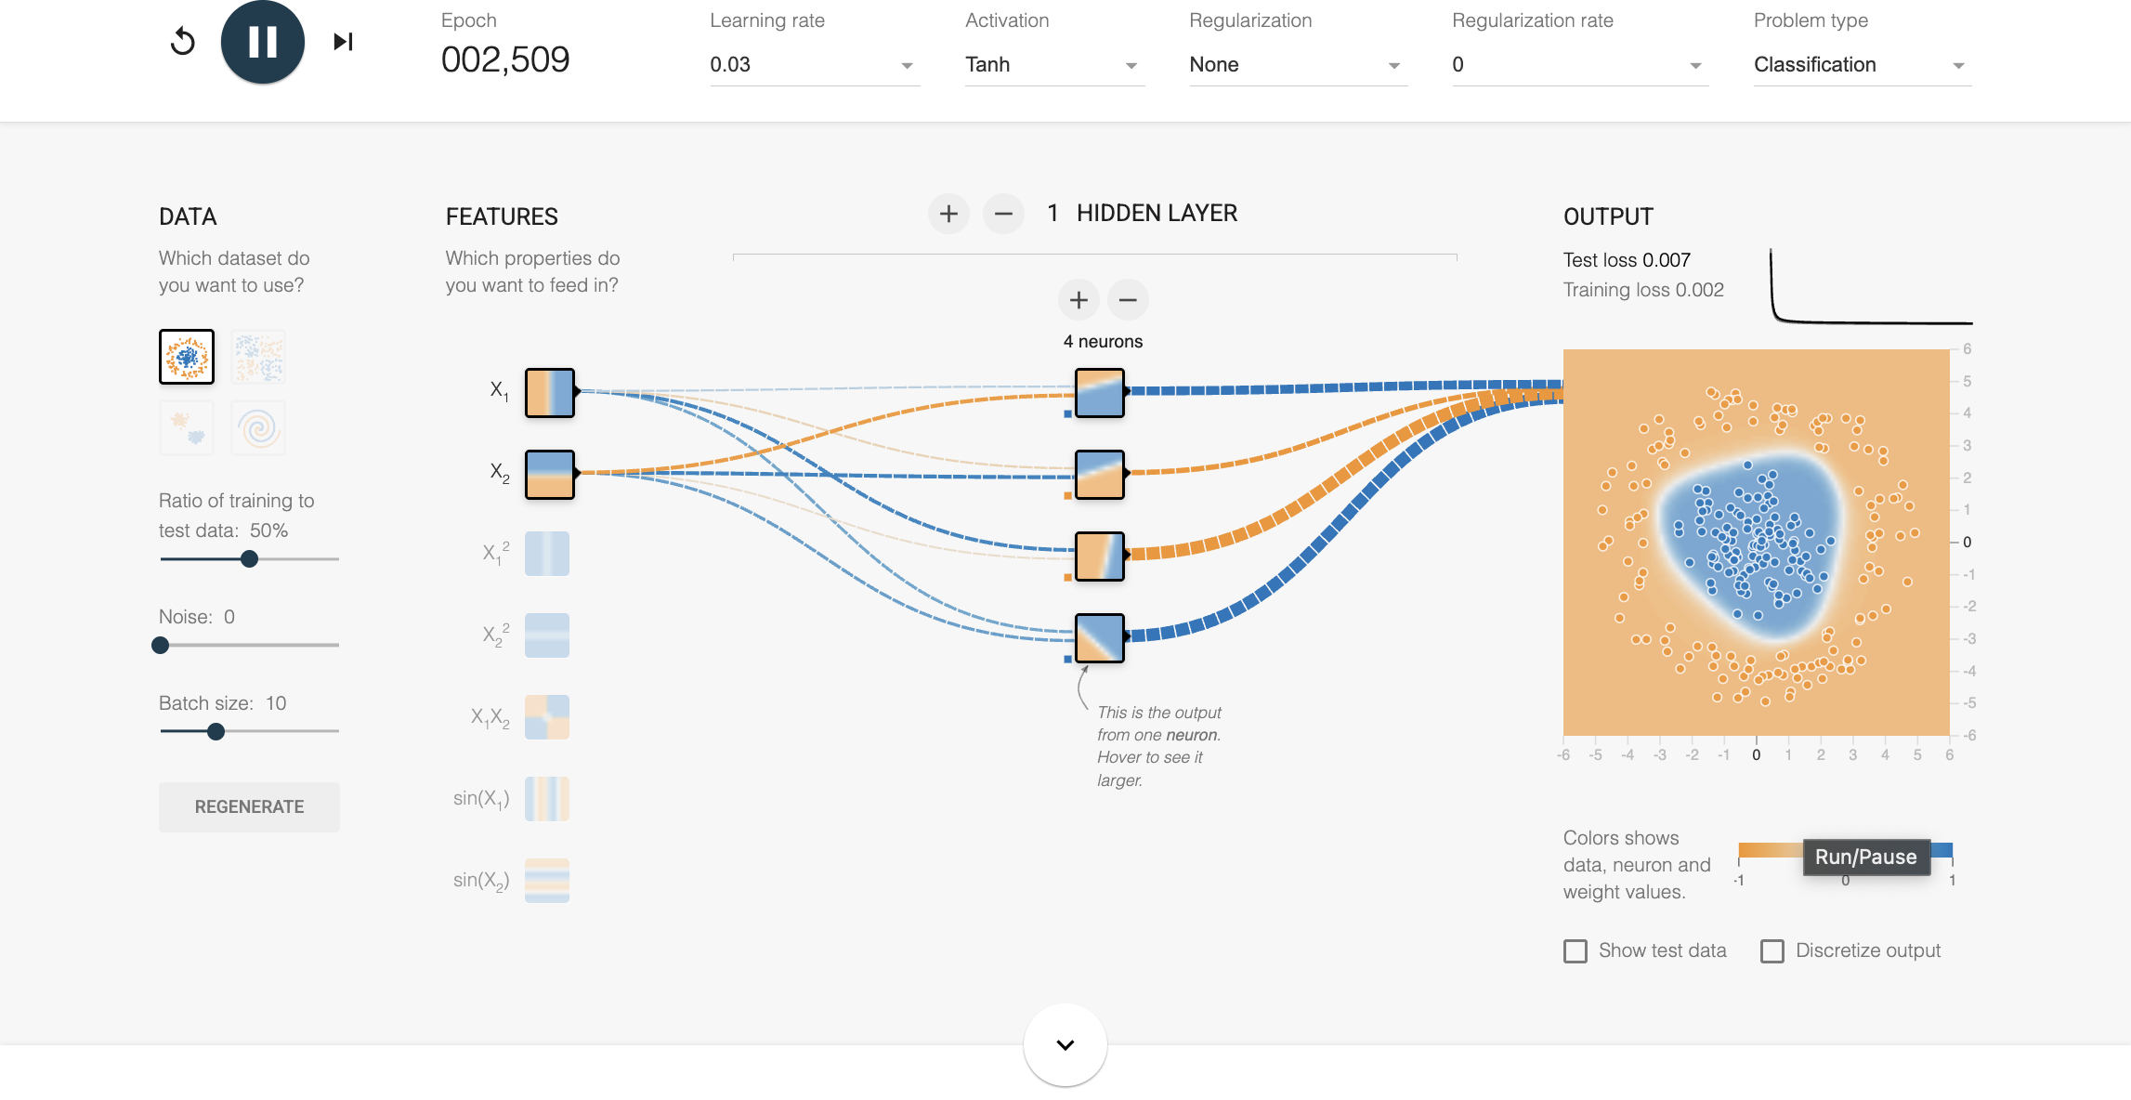
TensorFlow Playground example 2: medium complexity

Slide 9
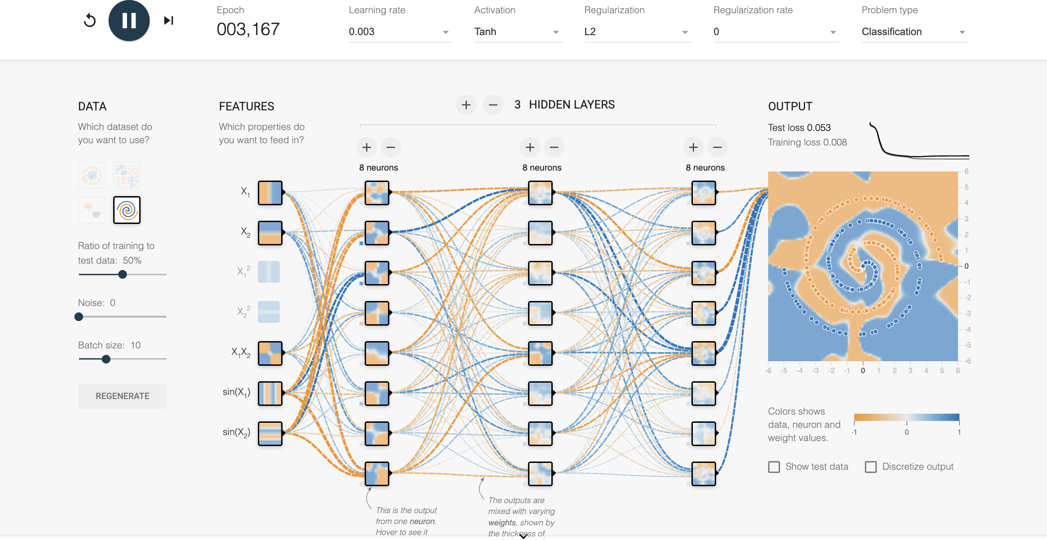
TensorFlow Playground example 3: deeper network.

Slide 10
Summary slide with insights gained.
Visualizing neural networks makes it easier to understand how data moves from inputs to predictions.
Layers, neurons, weights, and activation functions work together to learn patterns in data.
Loss functions and optimization algorithms improve model performance by reducing prediction error over time.
TensorFlow Playground showed that simple models can solve simple problems, but more complex data often needs additional hidden layers and neurons.
The exercise helped me see how network structure, feature selection, and model complexity affect training behavior and results.

Slide 11
THANKYOU

